Slide 1
Electric Power Subsystem (EPS)
Reece Krantz – Electric Power Subsystem Lead

Slide 2
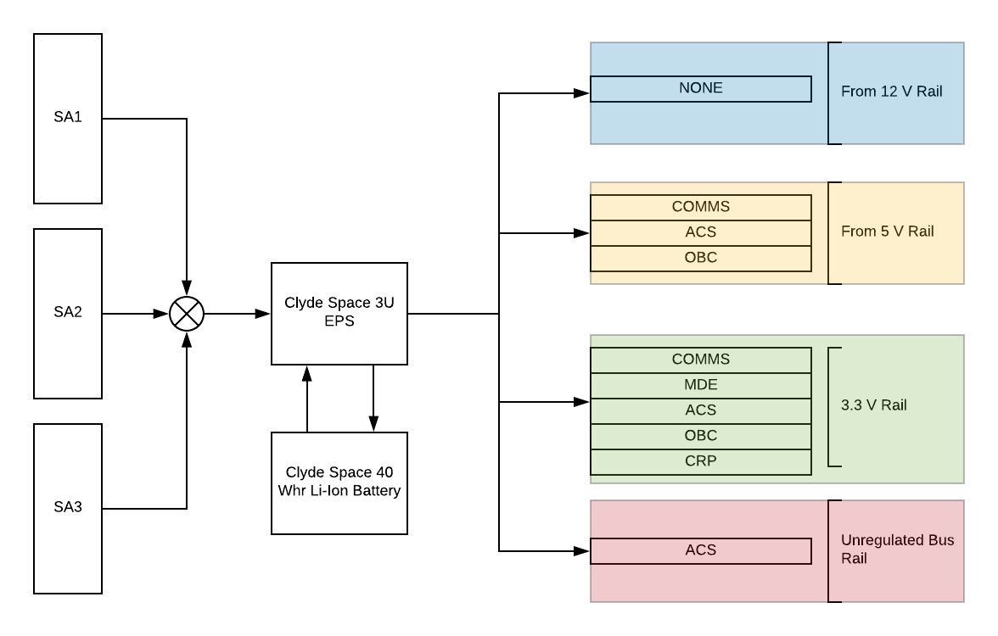
Mission Overview
The Electric Power Subsystem is responsible for the power management and distribution of the satellite.

Slide 3
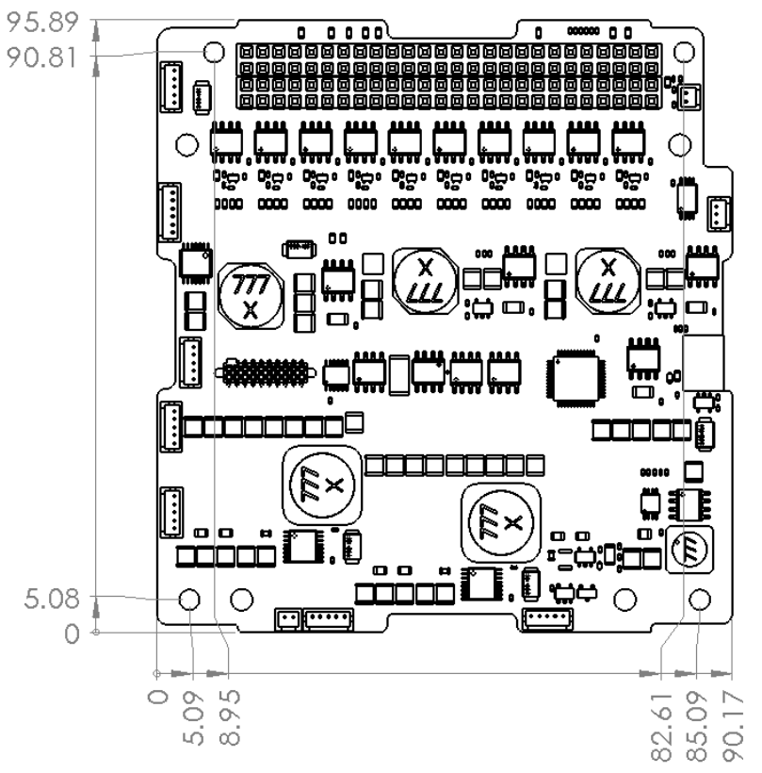
Clyde Space EPS Board
Maximum Ratings
  Buck BCRS – 30V
  SEPIC BCRS – 9.5V
  Battery – 8.3
  Operating Tempurature -- -40 to 85 C
  Storage Tempurature -- -50 to 100 C
  Vaccum – 10^-5 torr
  Radiation Tolerance – 10 kRad

Slide 4
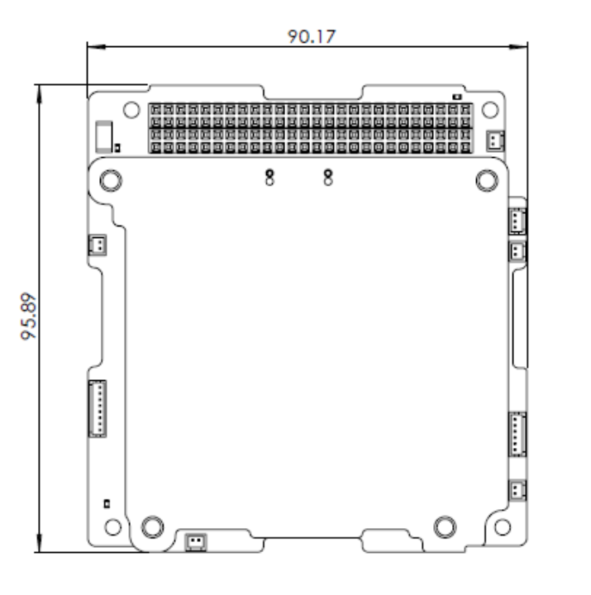
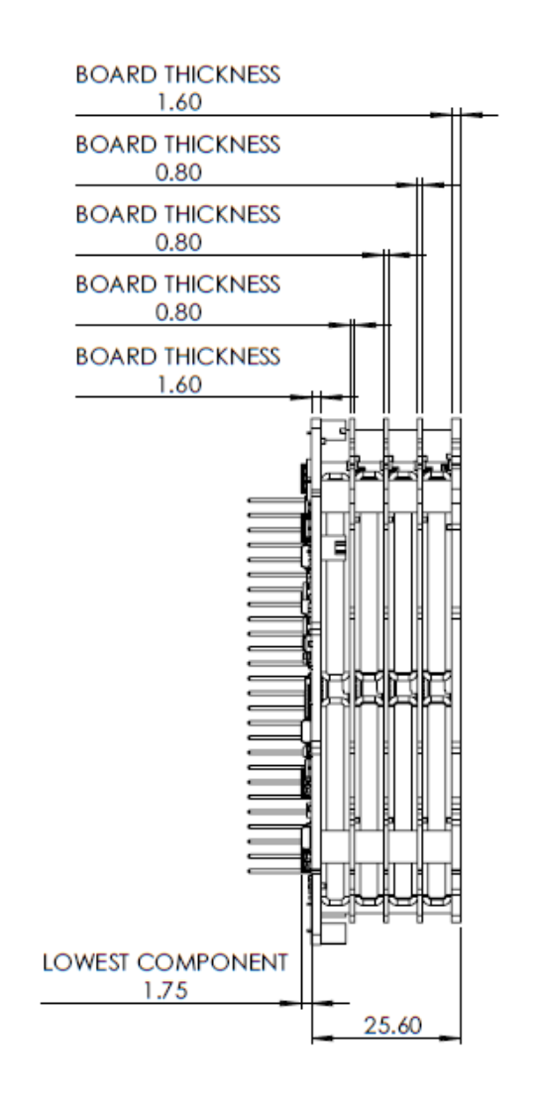
Clyde Space 40 Whr Battery
Operating Temp
  -10 to 50 C
Storage
  -10 to 10
Vacuum of 10^-5 Torr
Max Ratings
  Charge
    8.4 V
    8 A
  Discharge
    6.2 V
    8 A

Slide 5
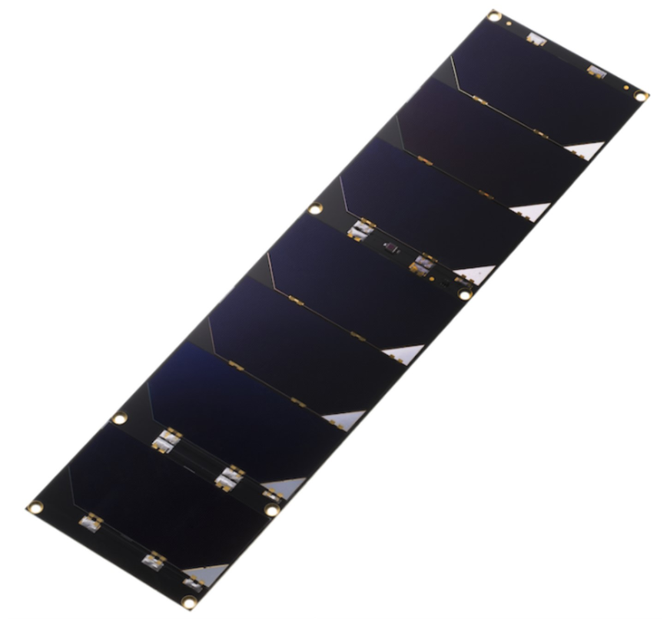
EnduroSat Solar Panels
  Seven CESI Solarcells
    211.05cm^2 effective cell area
    Temperature Sensor
    8.43 Watt in LEO
    Gyroscope and Sun Sensor
    Max Voltage of 16.31V
    Max Current 517 mA
    Weight of 136g

Slide 6
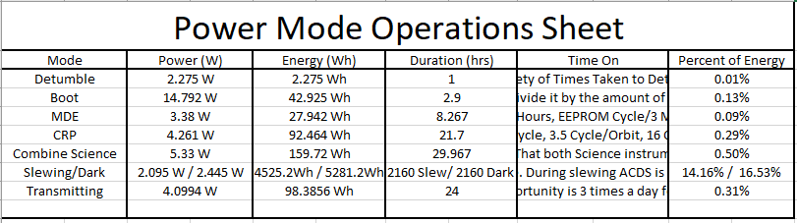
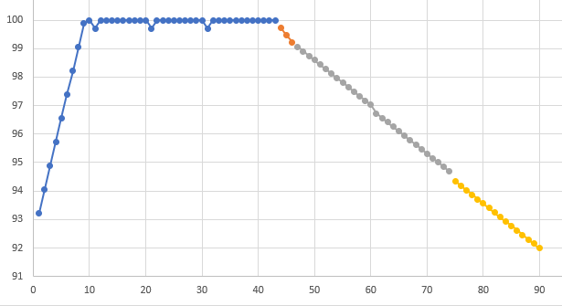
Power Modes
  Power Mode analysis allows unique modeling for any orbital configuration.

Slide 7
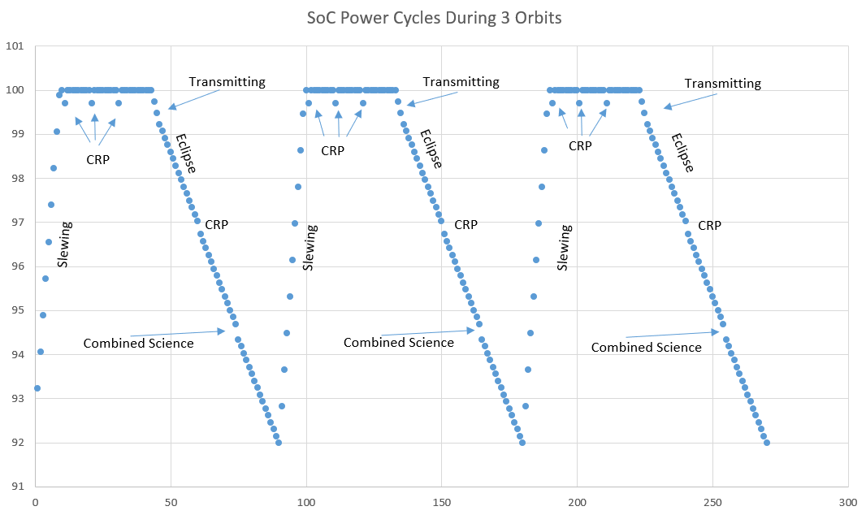
Power Modes
Activity Planning in Orbit
  Accomplish Scientific Goals
  Provide arcs for Communication with GS
Realistic Operation of Spacecraft
  Different Analysis of Power Budget
Aids Software Design
  Block Diagrams

Slide 8
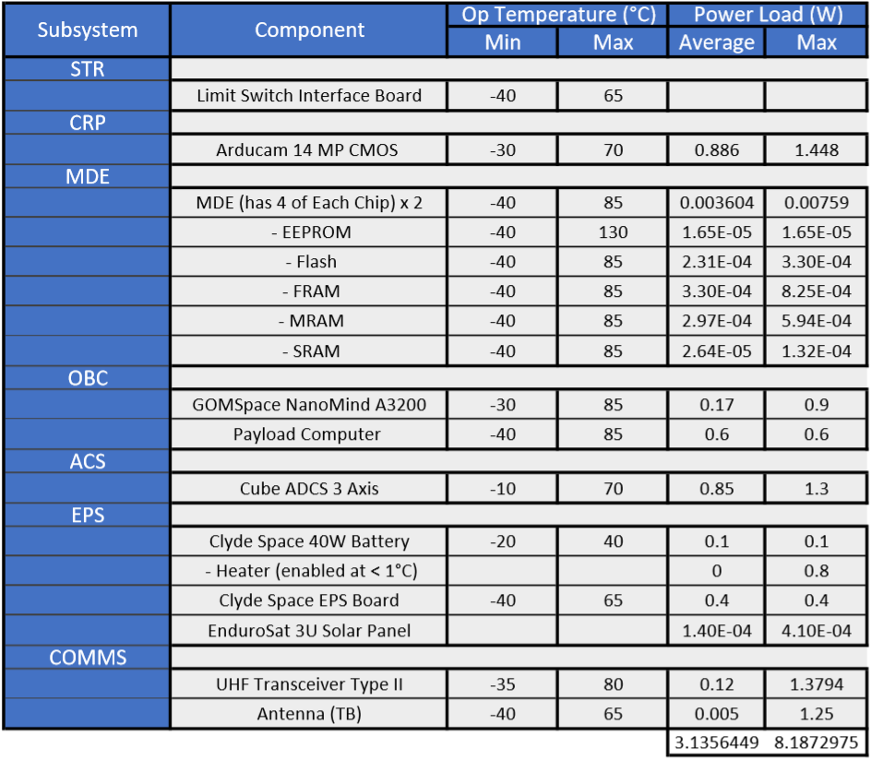
Power Budget

Slide 9
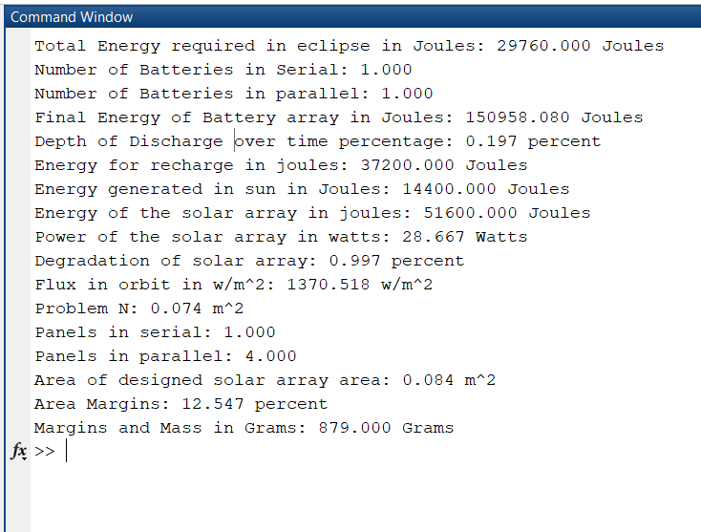
EPS Simulation
Relative Two-Body Problem Propagation
  States using Runge-Kutta
Initial Conditions of ISS plus some dV for Sat
Always Sun Facing
Eclipse/Sun is instant

Slide 10
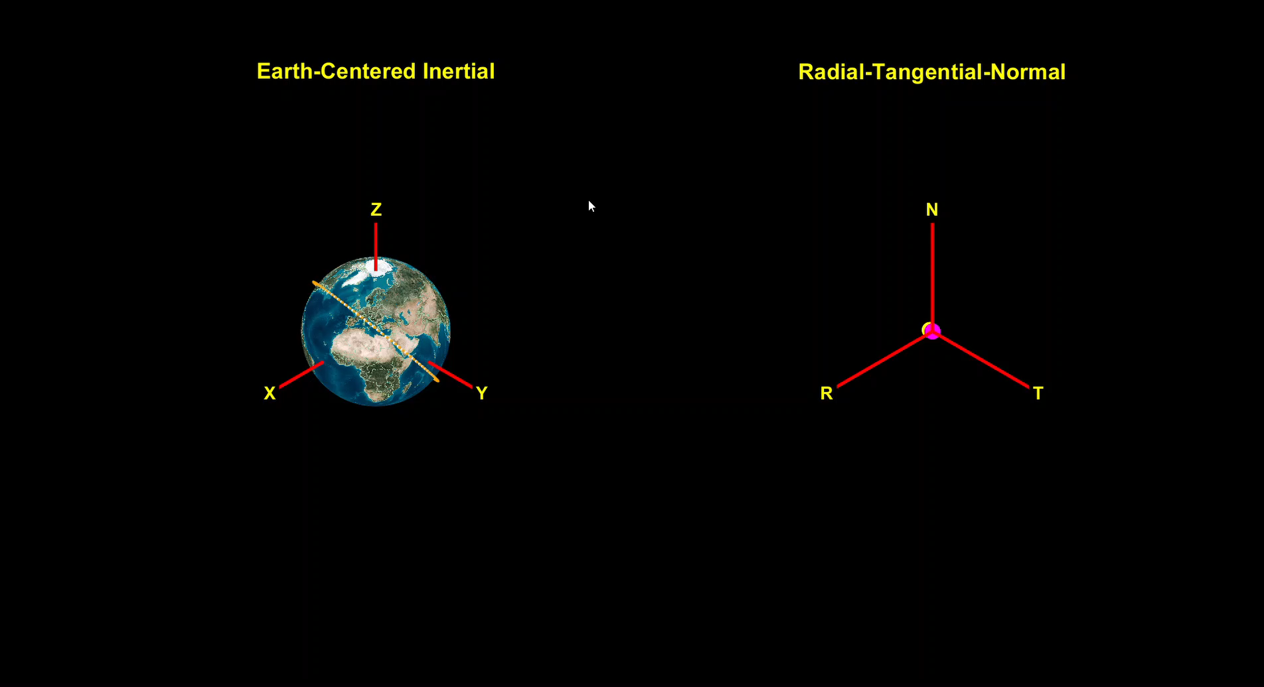
Animation of ISS and ES2 Orbit

Slide 11
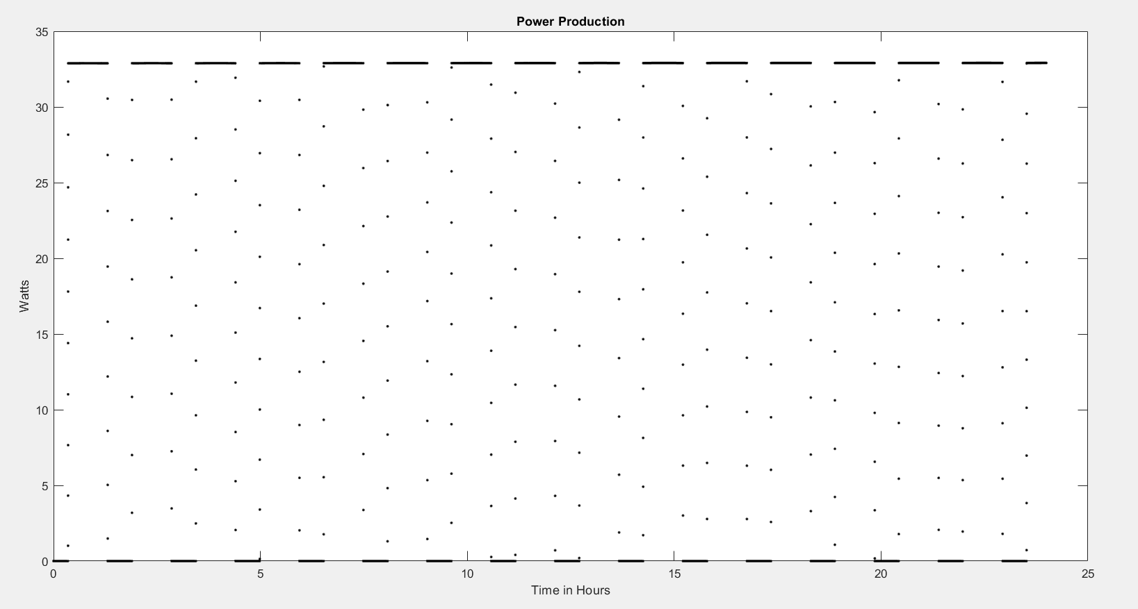
Power Production

Slide 12
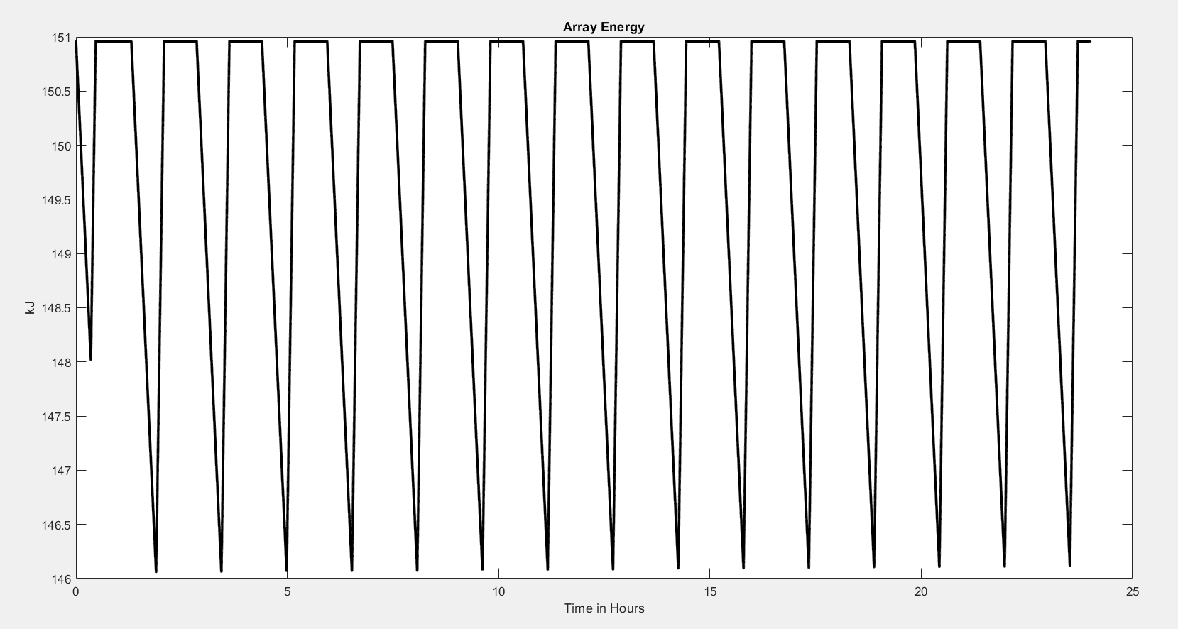
Array Energy

Slide 13
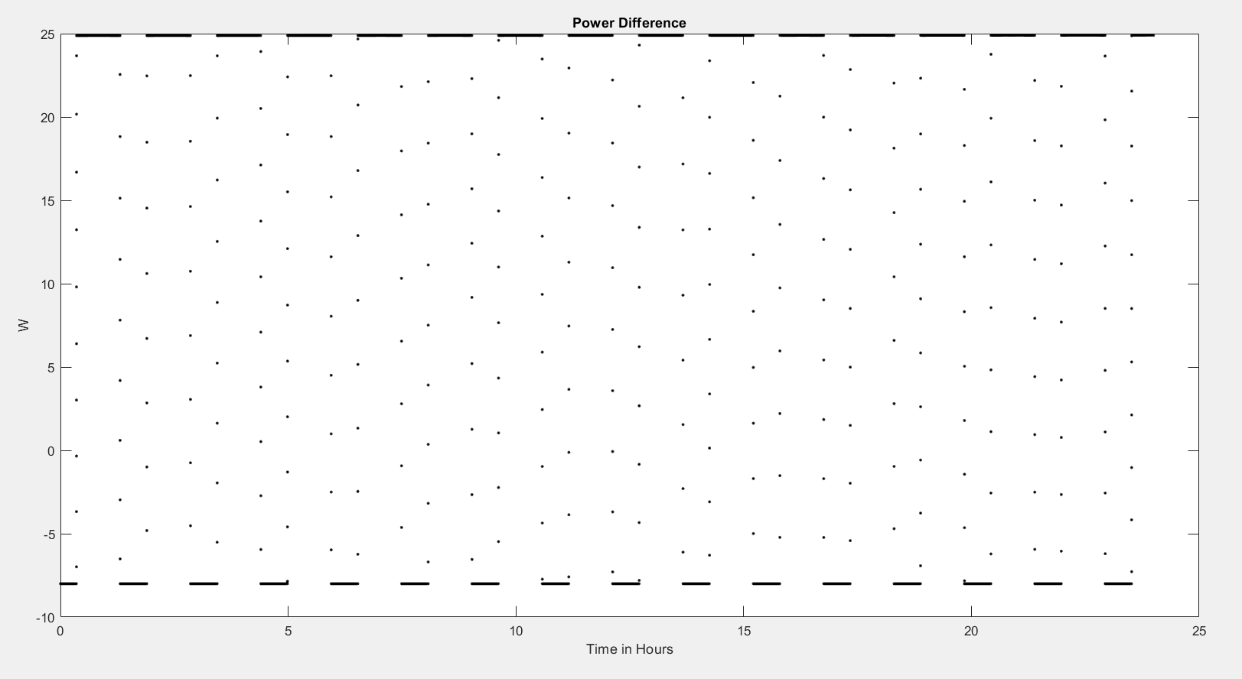
Power Difference

Slide 14
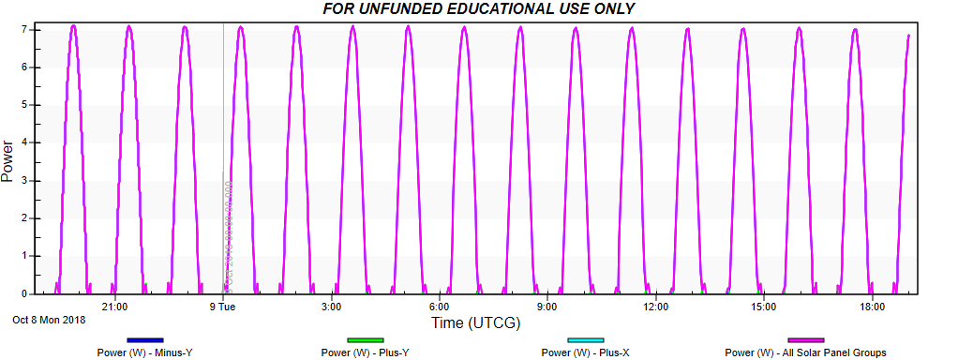
Improving Simulations
These simulations are good but can be better…
  N-Body Universe
  Spacecraft Orientation
  Power Seen in Orbit (W/m^2)
  Albedo Effects
  Perturbations
Validation of Code
  STK Solis

Slide 15
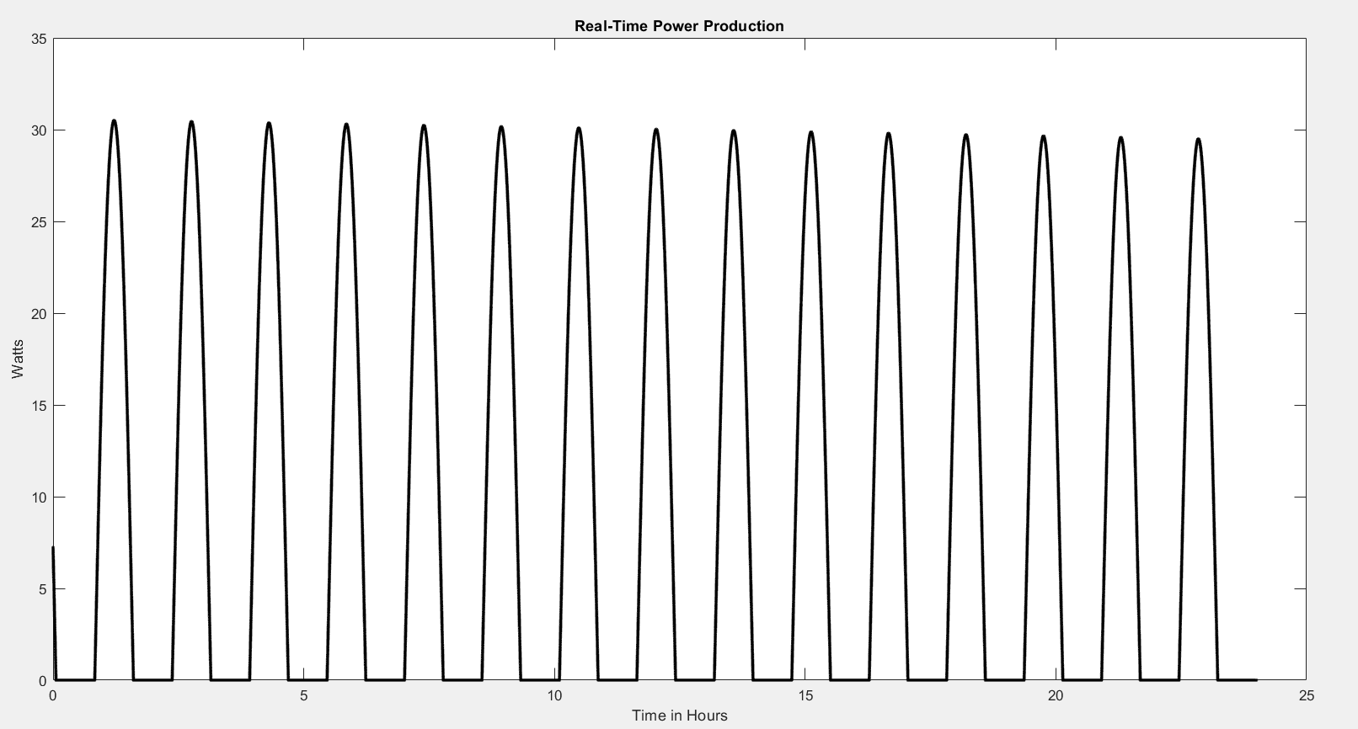
Real-Time Power Production

Slide 16
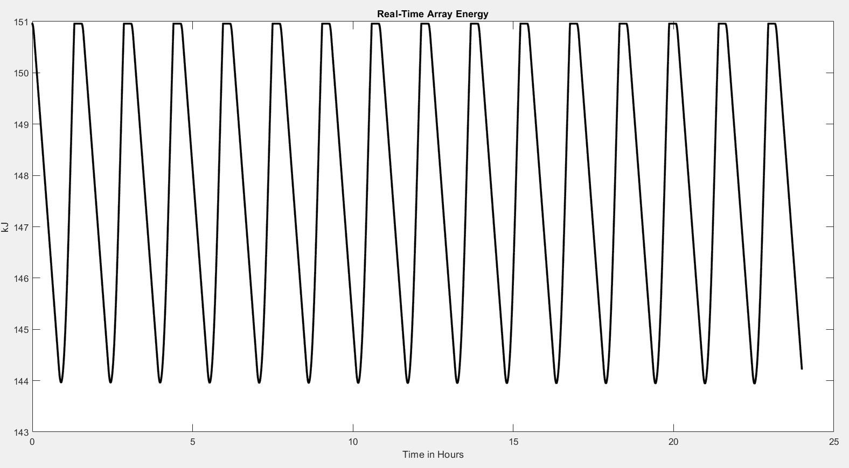
Real-Time Array Energy

Slide 17
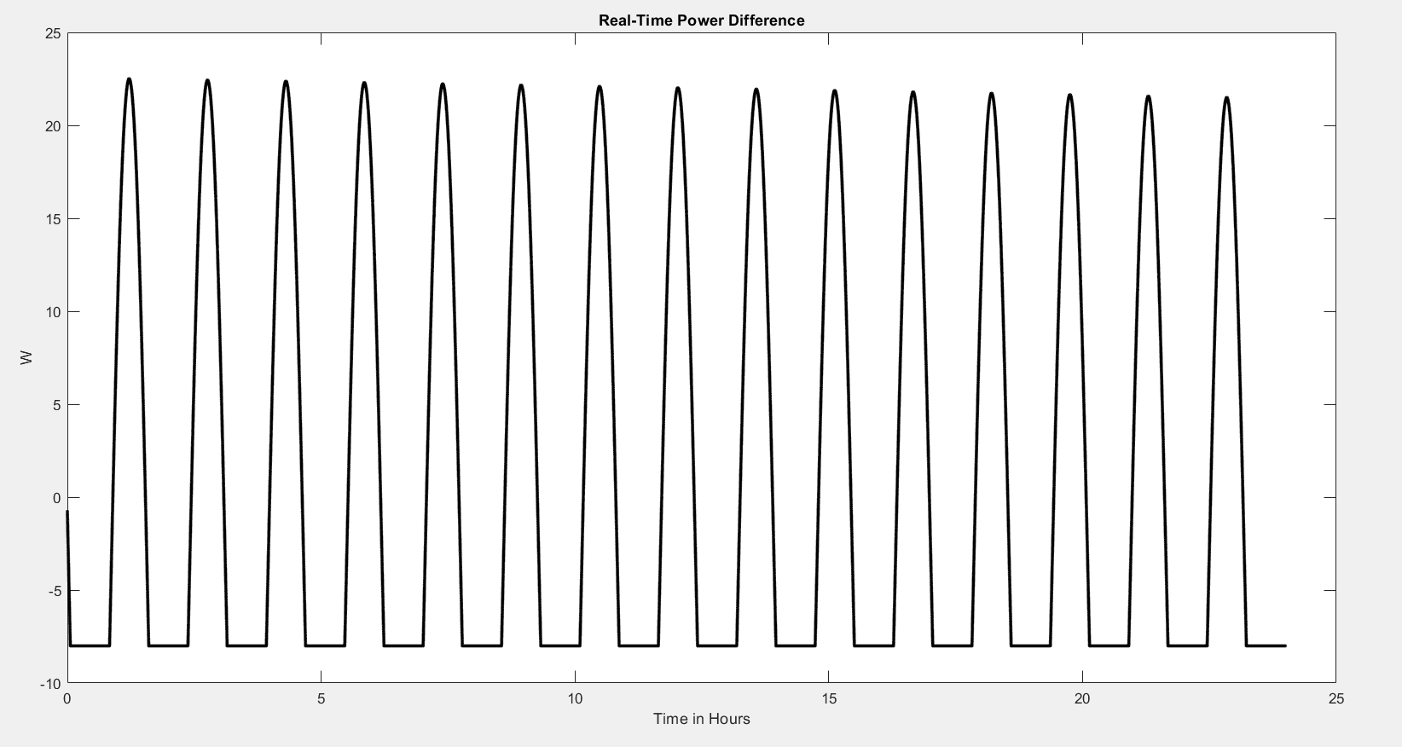
Real-Time Power Difference

Slide 18
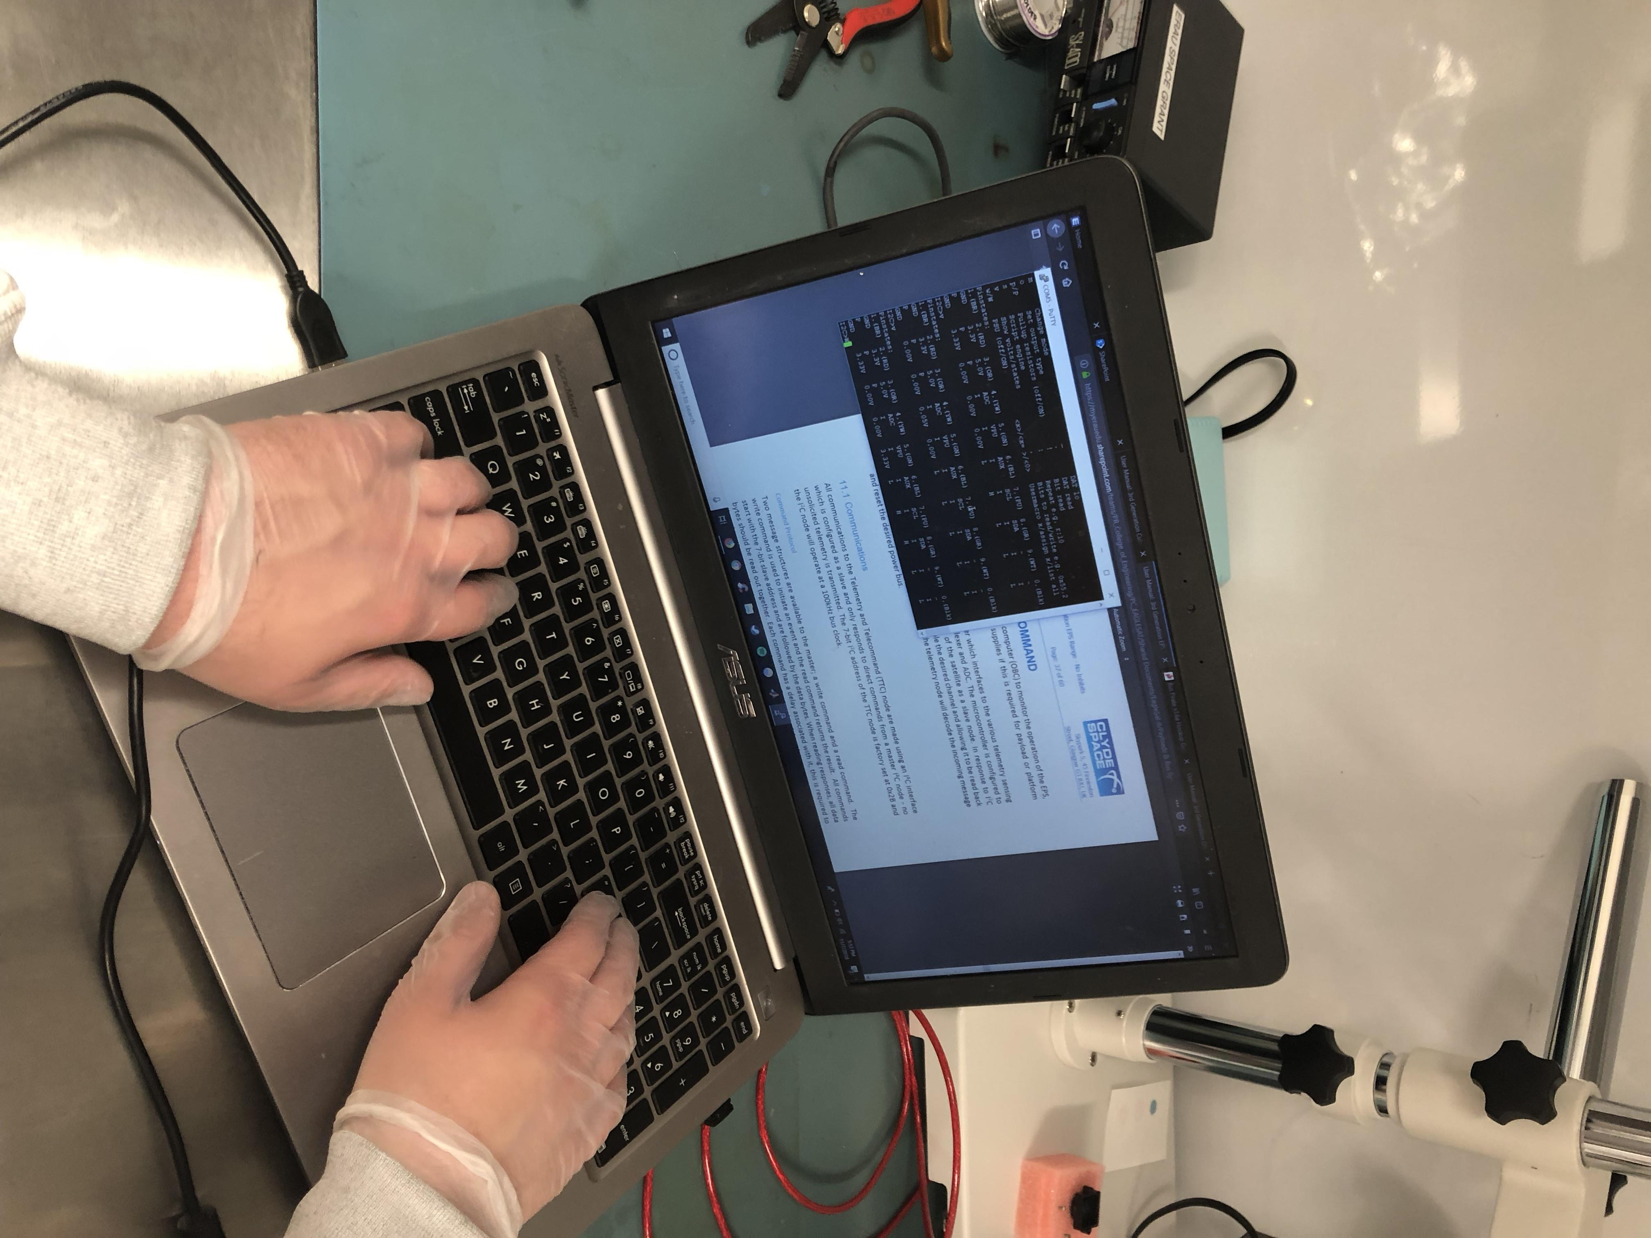
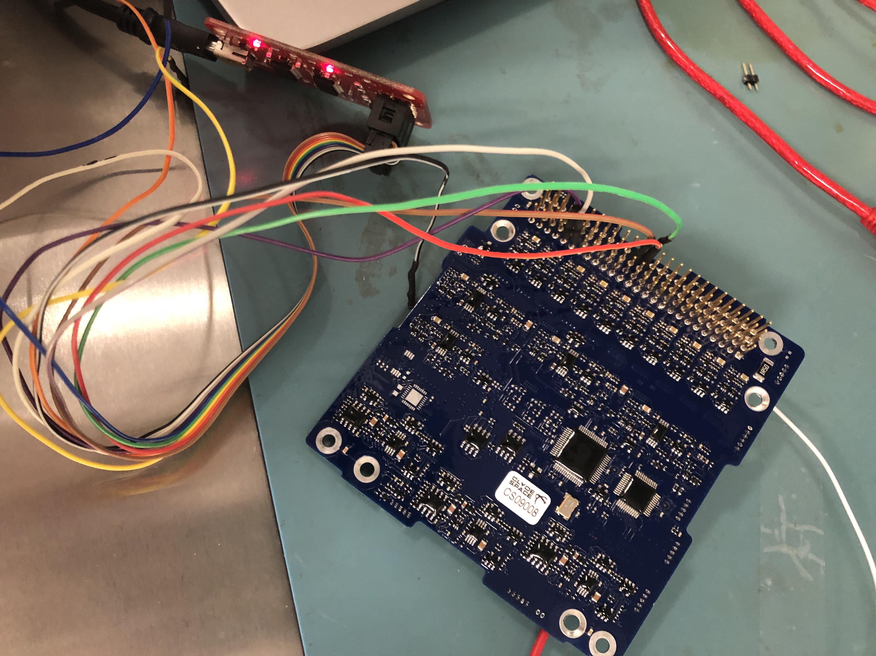
Testing
All testing is done in the clean room, with components being interfaced with I2C protocol
Using various systems including TI TM4C's, Arduinos and bus pirates.

